Slide 1
Brain Artery Network Biobank Web-based GUI Technology Review
Presentation by Kaiyu Zhang, Sharan Ranjit, David Prendez, and Cherin Lim

Slide 2
Background
Our application
Our project aims to create an accessible, large-scale, and open-source web platform that enables users to explore and visualize complex brain artery network structures and their associated analysis plots online with ease and precision.
Why do we need a web-based GUI design tool?
We need a tool to craft interactive web applications swiftly. Its user-friendly approach allows for the seamless integration of complex datasets and analytical visualizations, ensuring that our platform is not only powerful in its analytical capabilities but also intuitive for users to navigate and utilize effectively.

Slide 3



GUI Packages Considered
Streamlit
Dash by Plotly
D3
Quick prototyping
Data caching & High speed
Minimal setup
Community & Ecosystem
Interactive visualization
Plotly integration
Better for enterprise support
SVG visualizations in web browsers
JavaScript library
Intricate and allows for fine-control
Steep learning curve

Slide 4
Web-based GUI Choice: Streamlit
Rapid Prototyping: Streamlit turns data scripts into interactive web apps with minimal code, enabling rapid prototyping and deployment of data applications directly from Python scripts.
Simple Interactivity: It uses a straightforward and Pythonic API that allows developers to create widgets for interactivity without the need for callback functions, simplifying the process of building user interfaces.
Automatic Updates: Streamlit automatically updates the app's output whenever the user interacts with the interface, re-running the Python script from top to bottom, which ensures that the displayed data and visualizations are always up to date with the latest inputs.

Slide 5
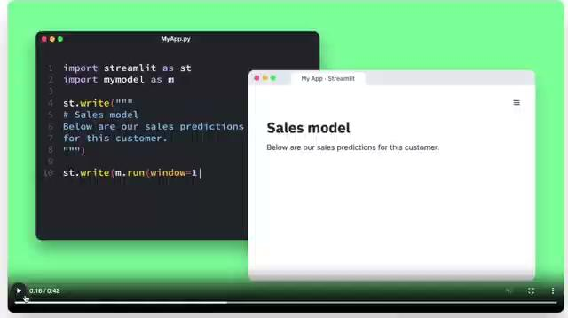
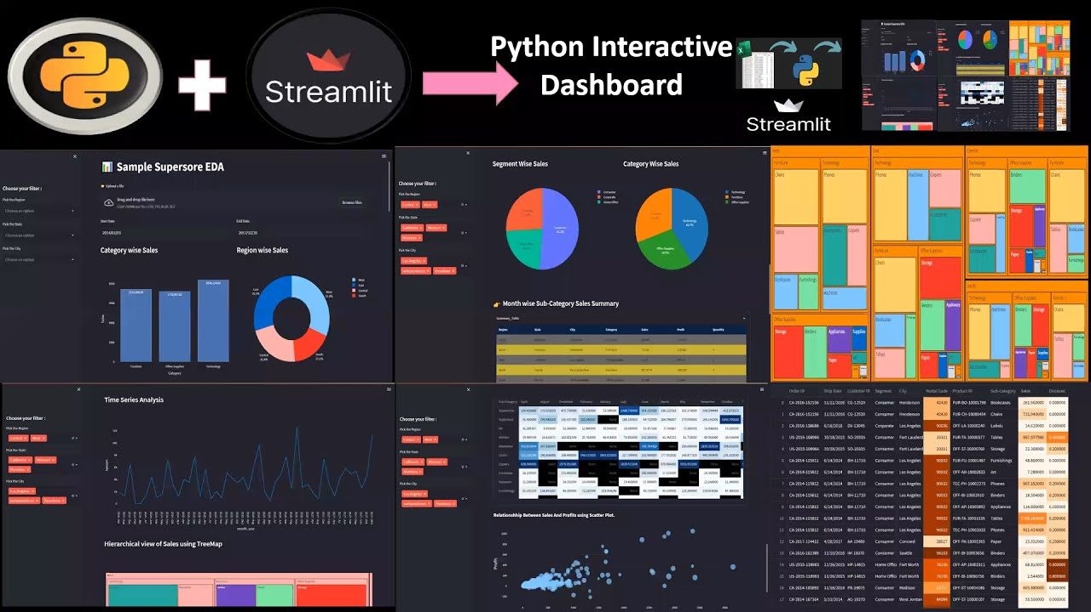
Streamlit Appeal
Relatively quick startup
Deploy apps within minutes
Compatible with most Python packages
Active community
Thorough tutorials and documentation

Slide 6
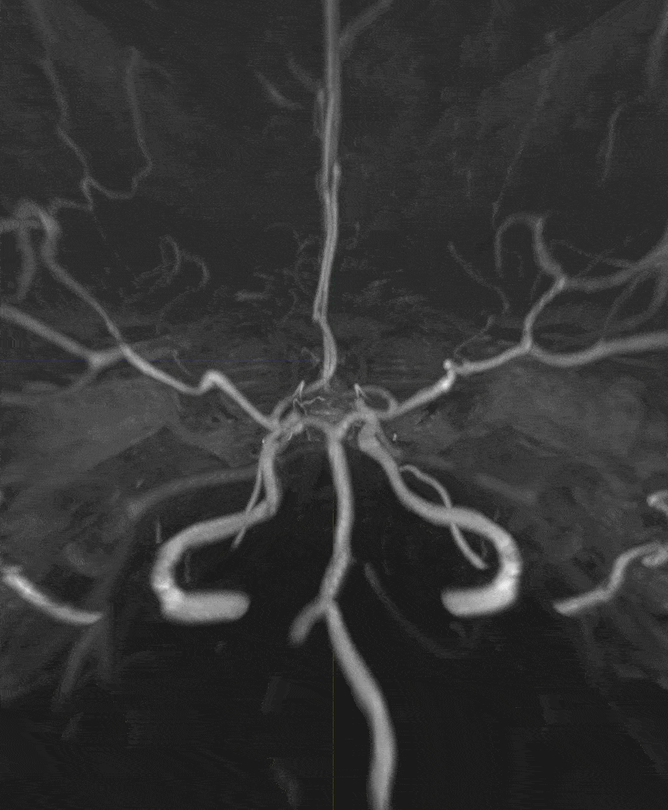
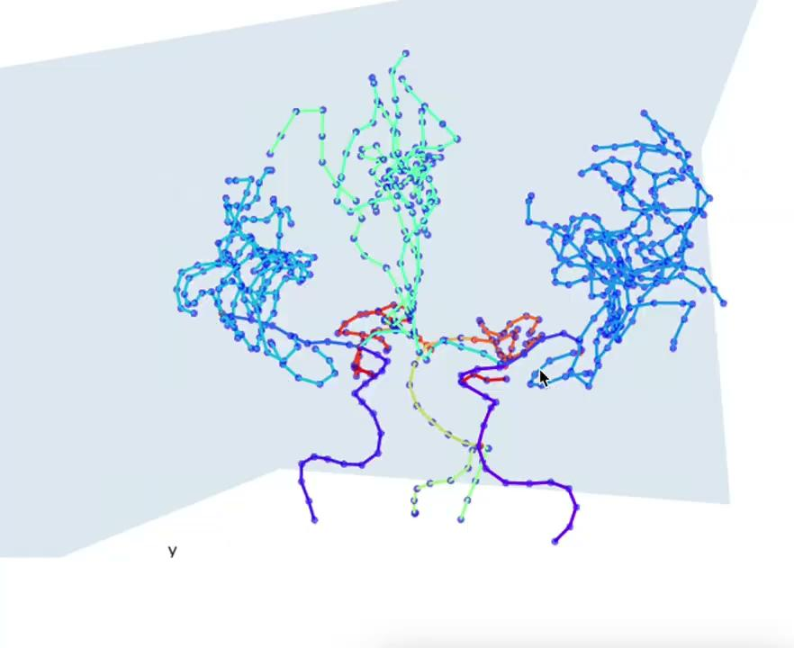
Streamlit Visualization with Plotly
Offline raw 3D image
Online processed vascular structure

Slide 7
Streamlit Drawbacks
Managing complex interactions and preserving state across callbacks can be less intuitive and may require workarounds
Customization
Less flexibility for layout and styling
Team collaboration
Often used by individual developers; limitations in large team collaboration and project management features
Scalability
Streamlit apps are not always the best choice for high-traffic scenarios
Primarily designed for prototyping and small to medium-sized applications

Slide 8

Thank you!

